Slide 1
Crowdsourcing Analysis of Bank Application Reviews
Class: Text Analytics
Professor: Yilu Zhou
Group Members: Annemarie Donohue,
Vanessa Asaro, Wanshan Mao, Yan Li, and Xinyi Xu
May 12, 2021
Notes:
Trend analysis - double check if reviews go back to previous years
Stock price → assumption too strong (many vectors related to stock price), mobil e app not significant enough for stock price
If a bank is doing very well with app does that mean that they have a tendency to grow online than offline

Slide 2
Introduction
Chase Bank is number one in their Annual Reviews as a:
Consumer bank, Multifamily lender, Investment bank in both investment banking fees and markets revenue
Mobile banking was imperative during restrictions of Covid-19
Crowdsourcing via reviews state needs of mobile customers
Text analysis needed to make sure Chase is accounting for customer wants
Can potentially achieve increase net revenue and new customers for the consumer and commercial bank sector
Notes:
41 M active mobile customer recorded in 2020
Customers are doing more than 80% of their transactions on their own.
Manage your account, deposit checks, pay bills, pay people, transfer money, budget/save,

Slide 3
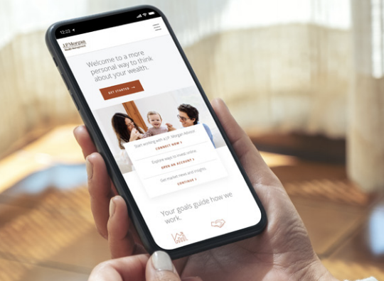
Problem Statement
How can utilizing crowdsourcing of consumer and commercial banking applications benefit the consumer and producer?

Slide 4

Data Description
Chase Mobile Application Reviews
Source: Apple’s Application Store
Variables: year (2015-2021), user, date, title, text, rating, month
60000 columns
Chase Mobile Application Updates Information
Source: Apple’s Application Store
Variables include: year (2019-2021), version, date, content
Chase Annual Report
Collect numbers from report of 2020
Some variables: year (2015-2020), number of branches, active mobile customers (11 total)

Slide 5
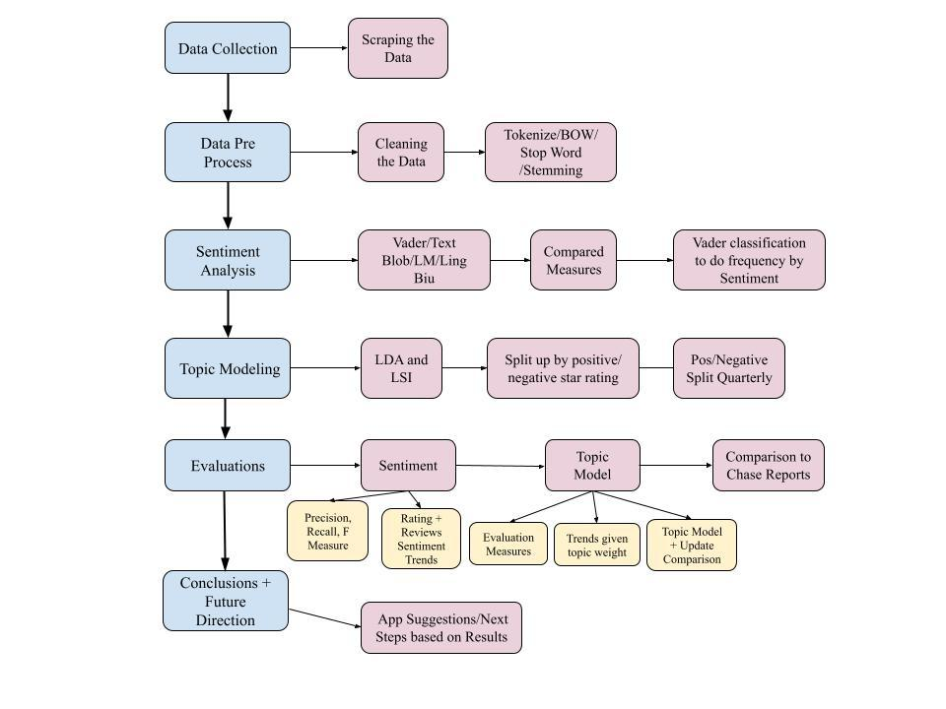
System Design

Slide 6
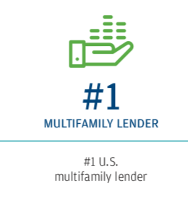
Data Collection and Cleaning
Chase Bank Mobile Application Reviews
Scraped from Apple’s Application Store starting from 2008 launch
Reduced to years from launch->2015-2021 resulting in 60,000->53668 rows of data
Altered columns for variables text, year, month and rating
Chase Annual Report 2015-2020
Hand collected various data points from 200+ page annual reports
11 variables about the growth rates of the consumer and commercial sector

Slide 7
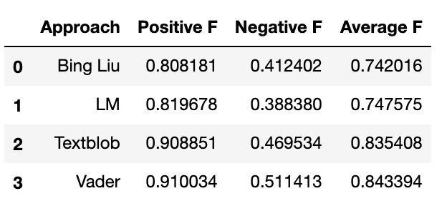
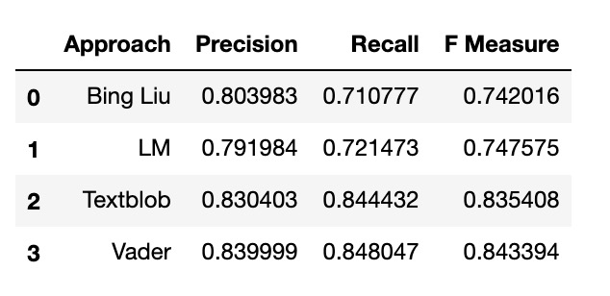
Data Preprocess
Compared outcome of sentiment approaches Bing Liu, Language Model, TextBlob, and Vader through precision, recall and f measure
Best approach being Vader due to highest measures
Vader also had the highest negative F measure which was important to identify negative reviews to aid in recommendations for app updates
Overall
F Scores

Slide 8
System Implementation: Frequency by Sentiment
Positive and negative frequency
The first word app is 3x the second word chase for both
Positive high count words include “easy” and “love”
Time was referenced negatively twice, indicating that customers are not happy wastefully spending time
iOS was mentioned negatively twice, meaning the updates were concerning to customers

Slide 9
System implementation: Topic Modeling
LDA: Latent Dirichlet Allocation
Make predictions of affiliations regarding inputers per each cluster or class using Bayes Theorem
Coherence measurement grant a quantifiable distinction between interpretable or irrelevant topics and terms.
5 topics with 10 highly associated words for final dimension reduction of 4155 unique tokens
LSA: Latent Semantic Analysis
Bases on tfidf, a statistical measure combination representing the importance of a term per document within a corpus or class
top 5 clusters with the top 10 associated terms

Slide 10
Conclusions: Topic Modeling
Score of TFIDF was consistently higher for LDA
more accurate word associations because there is a high frequency of terms in the document, therefore holding a higher weight
1 and 2 star findings: too many logins and updates, problems with simple banking services like deposits, time consuming customer service, and dislike of exclusive face ID use instead fingerprint alternative for login
LDA: 0.5; LSA: 0.3
4 and 5 star findings: bank app being user friendly and easy to use; Broad terminology was used, like “love” or “good.”
LDA: 0.8; LSA: 0.1

Slide 11
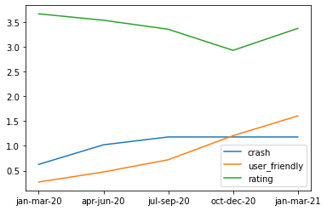
Conclusions:
Topic Modeling
Changes in Topic Weights and Ratings from January 2020 - March 2021
Crash and user friendly are two important and meaningful topics extracted
October - December 2020 is a turning point for the ratings, as well as for the topics as the positive topic exceeds the negative topic after that time
Increase in topic user friendly and decrease in topic crash, the overall ratings grow

Slide 12
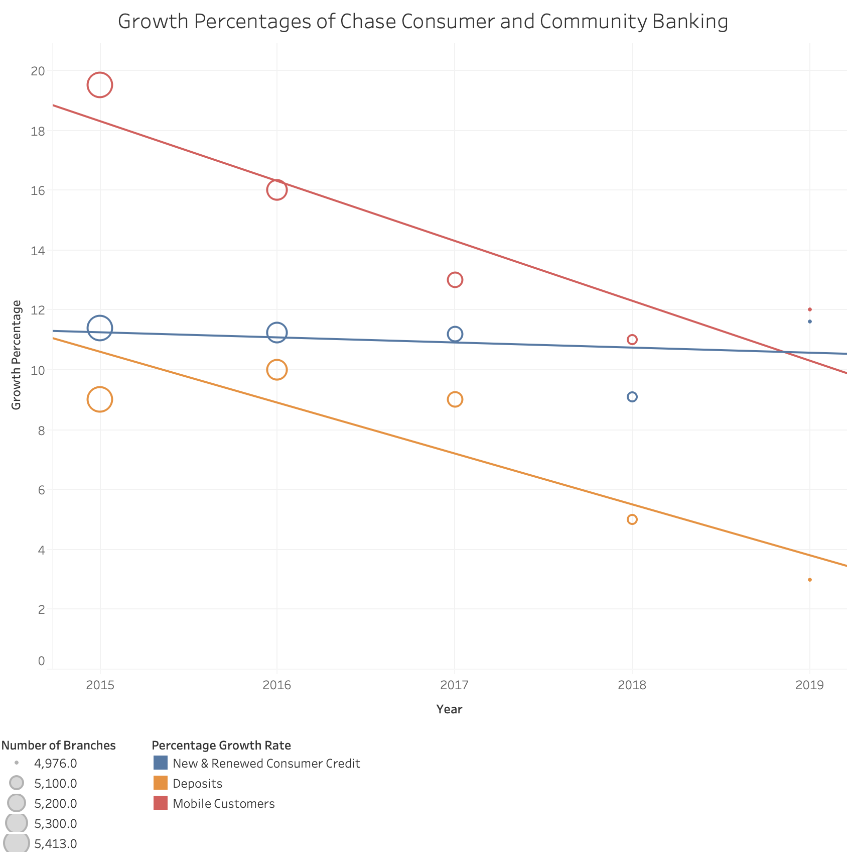
Conclusion: Chase Comparison
Number of branches is associated with growth percentages per year
Growth rate shows future decline through trend lines
Mobile customer and deposit growth rate keep a consistent variance showing correlation

Slide 13
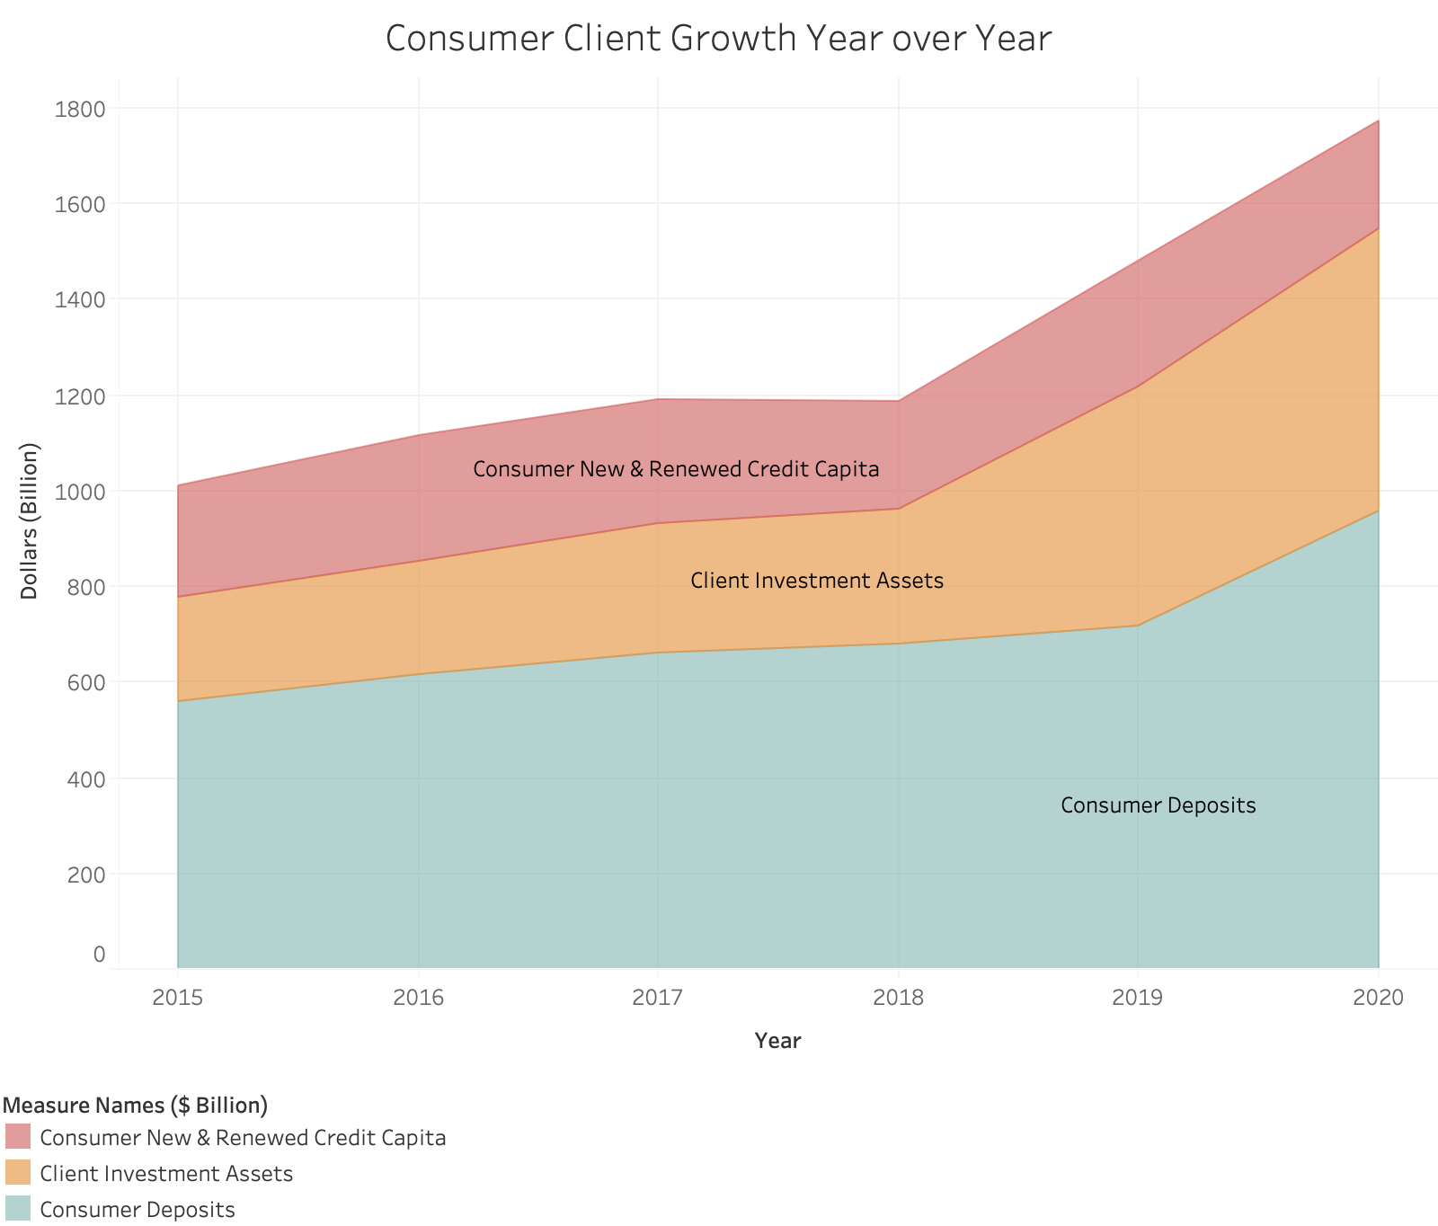
Conclusion: Chase Comparison
consumer new and renewed credit per capita, client investment assets and consumer deposits in a stacked area bar chart
consistent variance between the variables year over year, showing the correlation
Growth is shown overtime, with 2020 being the highest year

Slide 14
Conclusion and Future Direction
Too many logins and updates, problems with simple banking services like deposits, time consuming customer service, and dislike of exclusive face ID use instead fingerprint alternative for login
LDA better than LSA
Mobile application growth correlates with other revenue variables of the customer and community banking sector, including deposit growth rate
Guarantee growth in revenue year over year
Reward reviews in response to decline of customer feedback since 2016
Consolidate updates
Notes:
Compare to yearly revenue reports- new and renewed credit capital
Amount of assets from these accounts
Branches dropping

Slide 15
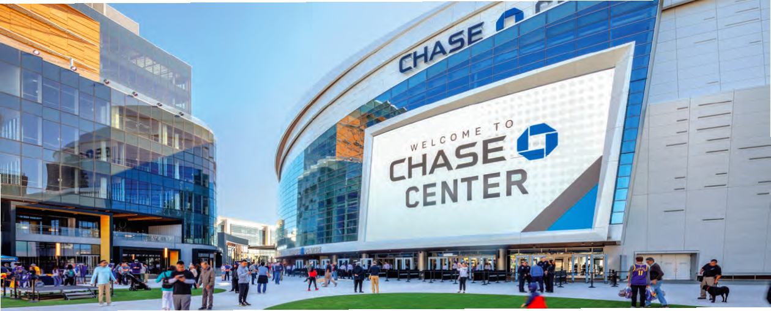
References
https://finance.yahoo.com/quote/COF/
https://finance.yahoo.com/quote/JPM?p=JPM&.tsrc=fin-srch
https://apps.apple.com/us/app/chase-mobile/id298867247
Chase annual reports: https://www.jpmorganchase.com/ir/annual-report

